Slide 1
Cell Membrane

Slide 2
Learning Objectives
outline the roles of membranes within cells and at the surface of cells
state that plasma (cell surface) membranes are partially permeable barriers
describe, with the aid of diagrams, the fluid mosaic model of membrane structure
describe the roles of the components of the cell membrane; phospholipids, cholesterol, glycolipids, proteins and glycoproteins;
outline the effect of changing temperature on membrane structure and permeability

Slide 3
Experimental work on plasma membrane
Damage to cell membrane kills the cell
Oil soluble substrates can penetrate quickly => contains lipid
Lipid solvents alter permeability properties
Theory
Monolayer?
But water in contact with both surfaces, bimolecular
Proteins added to model to explain its strength

Slide 4
Davson and Danielli 1935
Lipid bilayer coated on both sides with a layer of protein molecules
Calculated that thickness of membrane was about 7.5nm.
Phospholipid bilayer
Protein molecule

Slide 5
Singer and Nicholson 1972 Fluid mosaic model
Cell membranes have a consistency like oil, with sideways movement of molecules or membrane.
Fluid
individual phospholipid and protein molecules move around within their layer
Mosaic
pattern produced by scattered protein molecules when surface membrane is viewed from above.

Slide 6
Fluid Mosaic Model
A phospholipid bilayer
Transmembrane and peripheral proteins
Cholesterol
Glycoproteins
Glycolipid

Slide 7
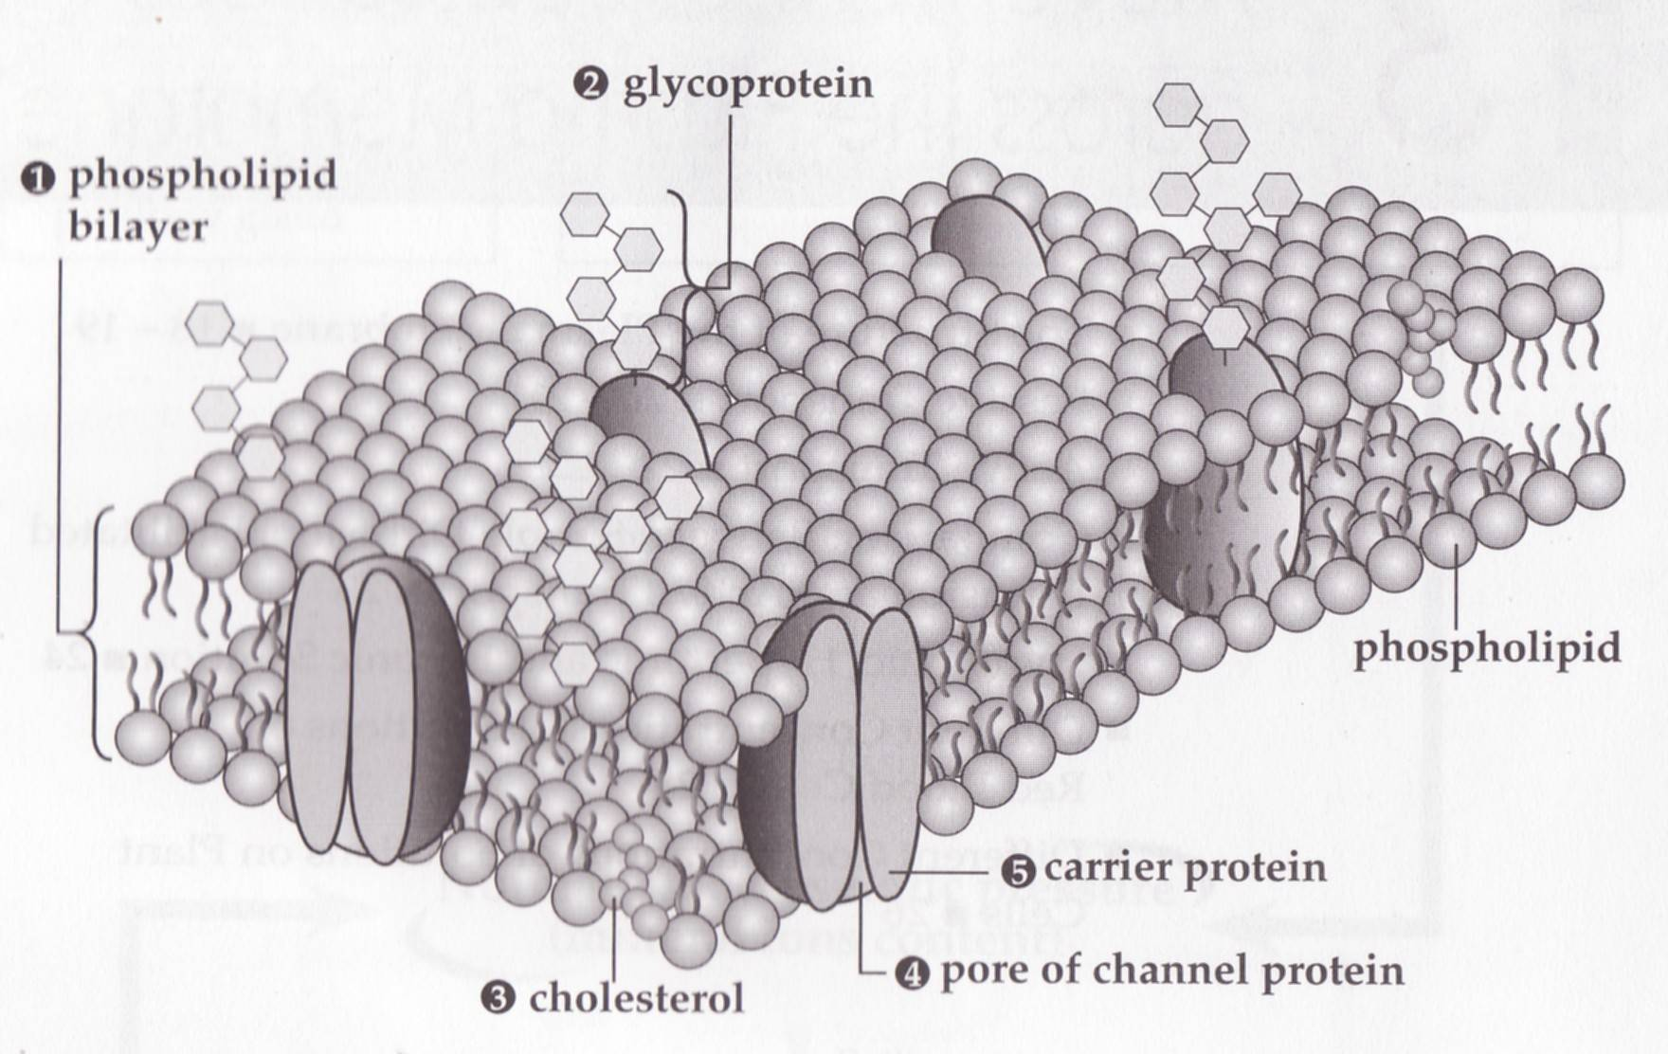

Slide 8
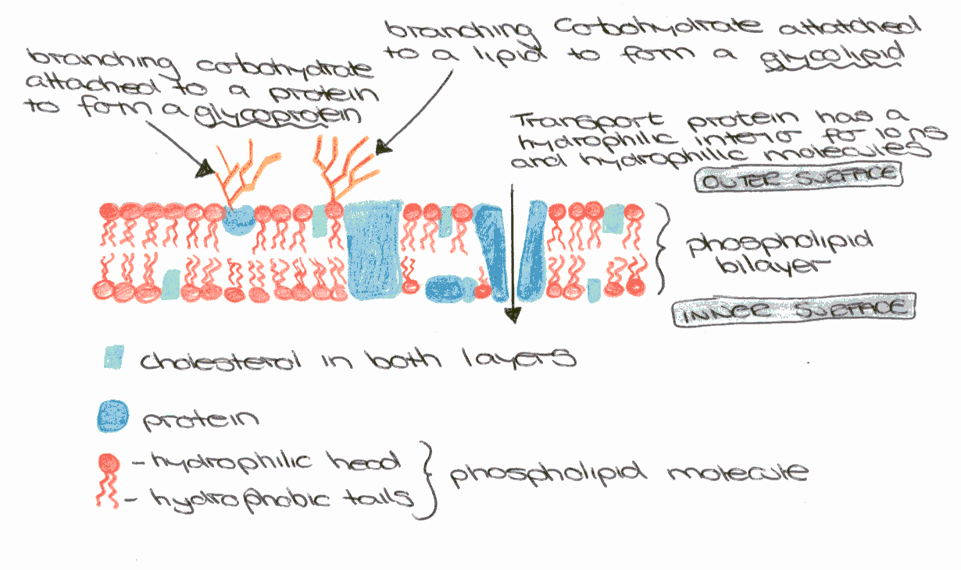
Cell Surface Membrane

Slide 9
Functions of the plasma membrane
Providing a partially permeable barrier
Compartmentalisation
Localising reactions in a cell
Transport of solutes
Signal transduction
Cell-cell recognition

Slide 10
Applying your knowledge questions
why can phospholipid molecules in a bilayer move only in the plane of the bilayer?
Phosphate head can not pass through the hydrophobic region in the centre of the bilayer

Slide 11
Applying your knowledge questions
Why do we describe cell membranes as partially permeable rather than semi-permeable?
Different membranes are permeable to a variety of substances and impermeable to a variety of others.
Semi-permeable suggests “half-permeable” which is unlikely to be the case in any membrane.

Slide 12
Roles of Components of Membrane
Phospholipid
Can form sheets (bilayer)
Form membrane bound compartments.
Act as a barrier to most water soluble substances

Slide 13
Roles of Components of Membrane
Cholesterol
Helps regulate fluidity of membrane
Stabilises phospholipid bilayer
Prevent ions/polar molecules passing through, important in myelin sheath around nerve cells.

Slide 14
Roles of Components of Membrane
Proteins
Intrinsic proteins – span membrane
Extrinsic proteins – embedded in one half of membrane
Channel forming proteins
Carrier protein molecules

Slide 15
Roles of Components of Membrane
Glycolipids and Glycoproteins
Short carbohydrate chains attach to lipids and proteins
Chains project into watery fluid surrounding membrane, forming hydrogen bonds with the water, and increasing stability of membrane structure.
Receptor molecules – bind hormones and neurotransmitters, e.g. insulin receptors in liver and muscle cells
Antigens – allow cells to recognise each other e.g. white blood cells

Slide 16
Investigating Cell Membranes
Analysis of pigment leakage from beetroot cells
Two investigations
Investigating the effects of temperature on the cell membrane
Investigating the effects of ethanol on the cell membrane

Slide 17
Investigating the effects of temperature on the cell membrane
Range of temperatures
0oC, 25oC, 50oC, 75oC
Fair test
List what you are changing
List what you are keeping the same
Diagram of set up
Results table (colorimeter reading)
Conclusions
Analysis
Evaluation

Slide 18
Investigating the effects of ethanol on the cell membrane
Range of ethanol concentrations
0%, 25%, 50%, 75% and 100%
Fair test
List what you are changing
List what you are keeping the same
Diagram of set up
Results table (colorimeter reading)
Conclusions
Analysis
Evaluation

Slide 19
Cell Signalling

Slide 20
Learning Outcomes
To explain the term “cell signalling”
To explain the role of membrane-bound receptors as sites where hormones and drugs can bind

Slide 21
Cell Signalling
Cells communicate with each other by signals
Cells must be able to detect various internal and external signals in order to co-ordinate the life processes of growth, development, movement and excretion.
Receptors can be
Internal – e.g. steroid receptors
External – e.g. insulin receptors

Slide 22
Signalling in animal cells
Signalling molecules fit into their receptors like keys into a lock
The shapes are complementary
There are 3 main ways
Neurones send signals direct to target cells using neurotransmitters (e.g. synapse)
Hormones travel long distances in the blood
Local hormones (e.g. histamine) stimulate cells in adjoining cells

Slide 23
Hormones
Endocrine cells secrete hormones into the blood stream
Target cells have receptors for the hormone molecule
When the hormone binds to a receptor the cell responds

Slide 24
Insulin
The pancreas secretes insulin, which is large and water soluble
Insulin binds to receptor molecules on the cell surface membrane of liver and muscle cells
This increases glucose channels in the cell membrane
Cells uptake more glucose, which lowers the blood glucose levels

Slide 25
Local hormones
These only travel short distances to adjoining cells e.g.
Histamine
Cytokines
Stimulate lymphocytes to divide by mitosis and produce antibodies
Stimulates phagocytes to become more active

Slide 26
steroids
As steroids are fat soluble, their receptors sites are inside the cells

Slide 27
Medicinal drugs
Are complementary to the shape of receptor molecules
Agonists
mimic the effect of the signalling molecule
Antagonists
Block the receptors to stop the signalling molecule from having any effect

Slide 28
Agonists
Salbutamol (ventolin)
Mimics adrenaline to relax smooth muscle in the bronchi
Drugs to treat schizophrenia mimic a natural neurotransmitter

Slide 29
Antagonists
Beta-blockers
Which block receptors to prevent heart muscle from increasing heart rate
Help to reduce blood pressure

Slide 30
Hijacking cells
Some viruses can bind with receptors on the cell surface membrane
HIV and helper T lymphocytes
Some poison can bind with receptors
BOTOX – toxin binds with receptors on muscle fibres and prevents them from working causing paralysis

Slide 31
Time to think about things?
Define growth
How do organisms increase in size?
How do organisms reproduce?

