Slide 1
Starter: Why do we want to produce GM organisms??
Improving features of the recipient organism:
Gives crops resistance to herbicides so farmers can use them as the crops are growing
Insert muscle growth gene into cattle
Engineering organisms that can produce useful products: pharming!
Insert insulin/growth hormone gene into bacteria for diabetic humans to use
Insert pharmaceutical chemical gene into sheep so they produce it in their milk
Insert beta carotene (vitamin A) gene into rice so that poor people have a better diet

Slide 2
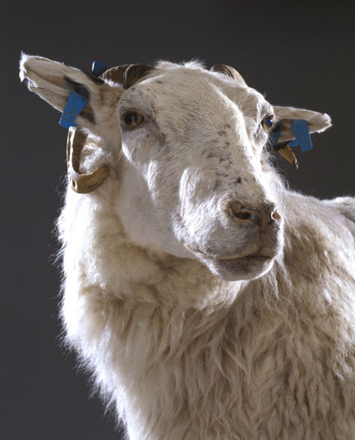
Transgenic sheep: Tracey! 1991.
DNA contained human gene for protein AAT
AAT normally made by liver
Inhibits enzyme Elastase
Elastase normally released from white blood cells: neutrophils
Elastase: Digests damaged/ageing lung cells/ foreign particles/bacteria
AAT prevents elastase attacking normal tissue.

Slide 3
5.2.3. Genetic Engineering
define the term recombinant DNA;
explain that genetic engineering involves the extraction of genes from one organism, or the manufacture of genes, in order to place them in another organism (often of a different species) such that the receiving organism expresses the gene product
describe how sections of DNA containing a desired gene can be extracted from a donor organism using restriction enzymes;
explain how isolated DNA fragments can be placed in plasmids, with reference to the role of ligase;
state other vectors into which fragments of DNA may be incorporated;

Slide 4
Task
Using your A3 summary sheet
The pictures
Summarise the topic using the slides given to you
Revision guide
Text book
Exam questions
ANY QUESTIONS???

Slide 5
Recombinant DNA: DEFINE
Recombinant DNA (rDNA): contains genes / nucleotides /sections of DNA/artificial DNA from two species/2 types of organisms;
GMO: Resulting organism from recombinant DNA technology
Genetic engineering extracts a gene/manufactures a gene to place it into another organism so the gene is expressed
Process of making a protein using DNA technology has 5 Stages:
Isolation of DNA: isolate and clone (make more) : in vivo (transfer to host cell using vector); in vitro (using PCR to amplify)
Insertion of DNA into vector
Transformation: transfer of DNA into host cell
Identification: of the host cells that have taken up the gene
Growth/cloning of the host cells

Slide 6
Obtaining the Gene
DNA probe used to locate the gene, then gene cut out using restriction enzymes
mRNA from transcription can be used as a template to make a copy of the gene, a single stranded cDNA by enzyme reverse transcriptase. This is made double stranded by DNA polymerase (Retrovirus have RNA rather than DNA: use enzyme reverse transcriptase to synthesise DNA from RNA)
WHY mRNA? mRNA is present in large amounts in cell making the protein /mRNA has been edited / does not contain introns / mRNA codes for single protein;
Difficulty of finding one gene among all the genes in the nucleus / large amounts of mRNA coding for protein/insulin will be present in the cells / idea that mRNA will be ‘edited’
Gene can be sequenced using an automated polynucleotide sequencer (markers etc.)

Slide 7
Restriction endonucleases (RE):
Naturally bacteria use as a defence measure.
Many types, each cuts a DNA double strand at a specific sequence of bases: recognition sequence. Target site is between 4-6 base pairs.
Cut straight line: blunt ends, cut staggered line: sticky ends: sequences are opposites of each other=palindrome.
In a sticky end, the cut end of the DNA double strand are left with a single strand which is a few nucleotide bases long.
Importance of sticky ends: provided the same RE is used DNA of one organism can be combined with DNA of other, due to complimentary base pairing.
The sticky ends are joined by an enzyme DNA ligase: joins the sugar-phosphate backbone of DNA
What bonds???
Phosphodiester bonds in sugar-phosphate backbone

Slide 8
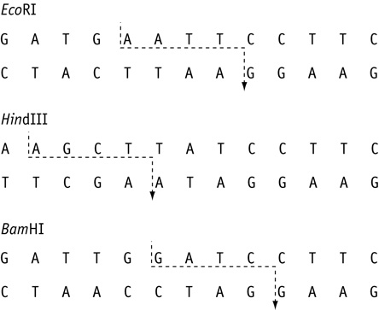
Restriction enzymes

Slide 9
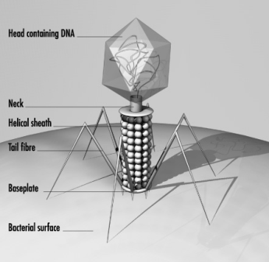
Vectors
A vector is the means of delivering a gene into a cell. It is a carrier into which the cDNA containing the required gene can be inserted
The result is recombinant DNA
Vectors can be:
Liposomes
Viral DNA (bacteriophages)
Bacterial plasmids (most common in GMO)
Vectors to introduce foreign DNA into bacteria can be a plasmid, BAC, bacteriophage
Vectors to introduce foreign DNA into animal cells can be plasmids, liposomes Virus, BAC
Vectors to introduce foreign DNA into plant cells can be plasmids, virus, liposomes and Agrobacterium tumefaciens

Slide 10
Inserting into recipient
Genes in vector are large so various methods can be used to get it into cell:
Electroporation = high voltage pulse disrupts membrane
Microinjection = DNA injected using a micro-pipette
Viral transfer = virus vector infects cells
Ti plasmid = circular DNA in bacteria that infects a plant’s genome
Liposomes = DNA wrapped in lipids that are fat soluble and diffuse across the lipid membrane

Slide 11
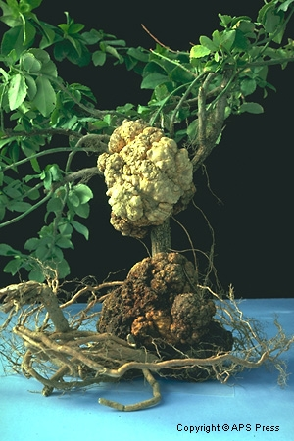
Introducing new genes into crop plants:
1. Soil bacteria: agrobacterium tumefaciens causes crown gall disease in dicotyledonous plants
Enters plants through wound, stimulates the production of a gall/ tumour in the stem
Growth of gall is due to Ti plasmid in bacterium
Becomes incorporated into host plant cells, replicates, hormones released which stimulate the growth of tumour cells
Plasmid can be isolated, tumour inducing gene removed, new desirable gene inserted: vector desired gene

Slide 12
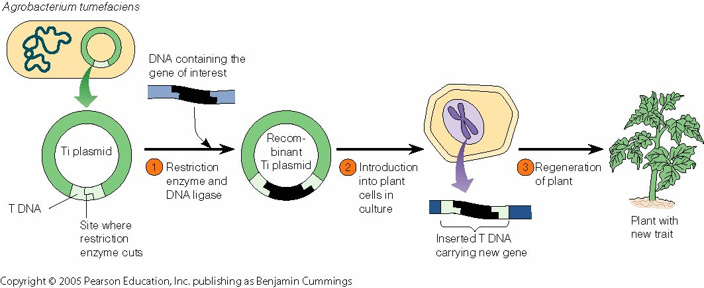
The resulting callus ( undifferentiated tissue) produced by plant cells can be induced to transgenic plants containing desirable genes
(Transgenic plants possess a gene or genes that have been transferred from a different species. “Transgenic plants" refers to plants created in a laboratory using recombinant DNA technology)

Slide 13
Liposomes in CF
Gene therapy: Treat cause rather than symptoms...HGP
Normal alleles of gene inserted into target cells: GM virus /liposomes
Normal form of gene is transcibed and translated
Functioning protein produced in target cell
1993 trials/ temporary improvement as loss of cells with allele (15 days)

Slide 14
5.2.3. Genetic Engineering
explain how plasmids may be taken up by bacterial cells in order to produce a transgenic microorganism that can express a desired gene product;
describe the advantage to microorganisms of the capacity to take up plasmid DNA from the environment;

