Slide 1
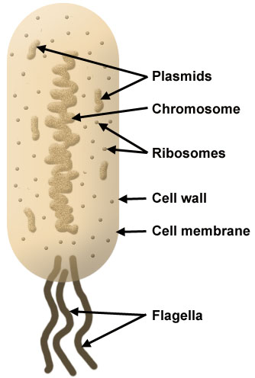
BACTERIA: Plasmids
Found in Bacteria
Small circular loops of DNA
Able to replicate within a bacterial cell ( independently from bacterial chromosome)
Used widely in gene technology: size/ replication
Plasmids often carry antibiotic resistance genes

Slide 2
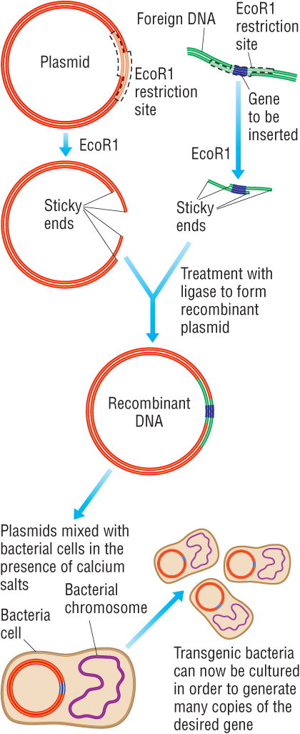
Plasmid Vector
Plasmids cut with restriction enzyme used to isolate the chosen gene
Complimentary sticky ends formed
Plasmid and gene mixed and they combine
Plasmid then seals and forms recombinant plasmid with help of ligase enzyme
Plasmids mixed with bacterial cells which take up plasmid
Less than a quarter of 1% of bacteria take up the plasmid and they are now known as transformed bacteria or transgenic bacteria (changed genes)

Slide 3
Transformation
Once the recombinant DNA has been formed it has to be inserted back into the bacteria:
Transformation= recombinant plasmid+ Bacterial cell+ calcium ions+ temp change (freezing-40°C)=bacteria becomes permeable: allows plasmid to enter
Identifying transgenic bacteria: Antibiotic resistant genes inserted into plasmids can act as markers. If the bacteria is grown on the antibiotic and survives the plasmid must be recombinant

Slide 4
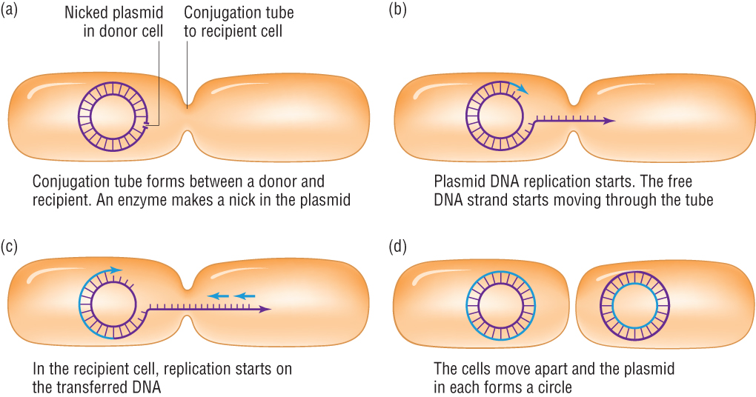
Bacterial Conjugation
Bacteria are capable of conjugation- exchanging genetic material
They pass plasmids between each other e.g. for antibiotic resistance
Swapping DNA is worrying as it speeds up resistance in bacterial populations e.g. MRSA
Advantage to the bacteria is genetic variation!

Slide 5
Genetic Engineering
outline the process involved in the genetic engineering of bacteria to produce human insulin;
outline how genetic markers in plasmids can be used to identify the bacteria that have taken up a recombinant plasmid;
outline the process involved in the genetic engineering of ‘Golden RiceTM’ (HSW6a);

Slide 6
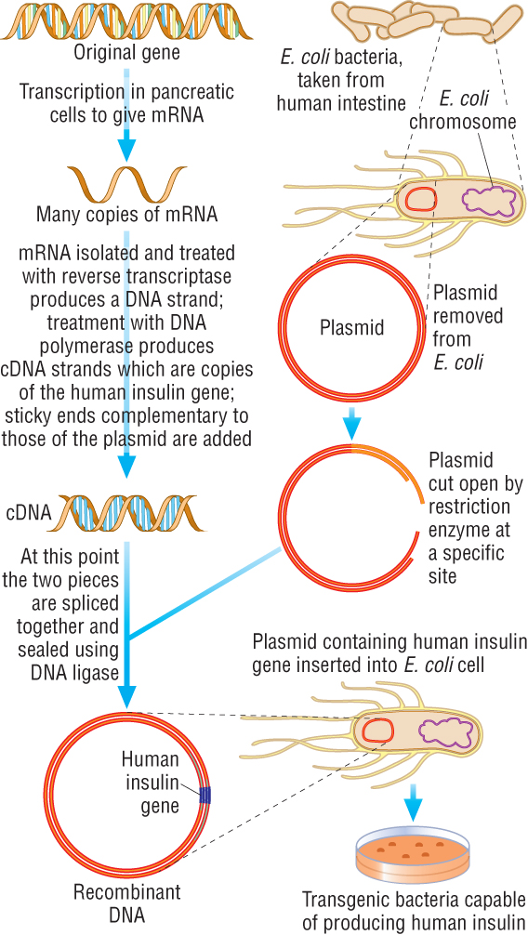
Type 1 Diabetics cannot make insulin
mRNA for the insulin gene extracted from pancreas cells
Used reverse transcriptase to make a cDNA strand (the same as the template one would have been)
DNA polymerase and free nucleotides added to make DNA double stranded
Copies made called cDNA gene and unpaired nucleotides (GGG) added to make sticky ends (complimentary to plasmids se)
Plasmids cut with restriction enzyme, sticky ends CCC, and mixed with cDNA, then sealed with ligase forming recombinant plasmids as they have new DNA in them
Plasmids mixed with bacteria and are taken up
Bacteria grown on agar plates producing a colony of clones

Slide 7
Not all bacteria take up plasmid
Three different colonies can grow:
Some from bacteria which did not take up plasmid
Some which has sealed upon itself
Some that have taken up the plasmid: transformed
A method is then needed to identify the transformed bacteria

Slide 8
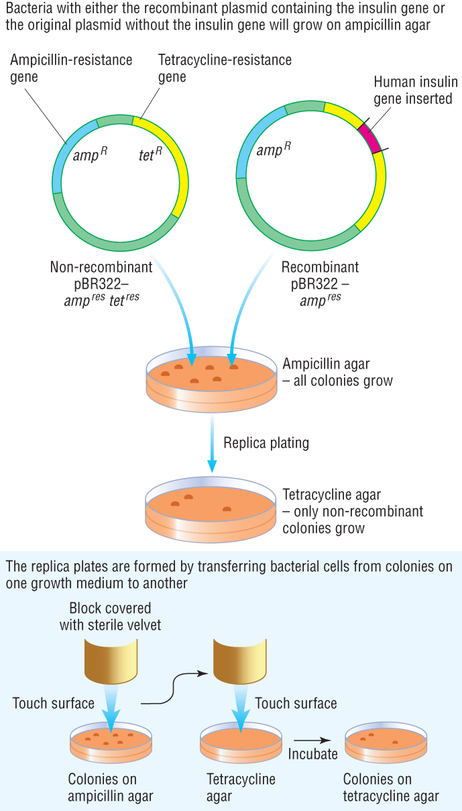
Replica plating
Original plasmids have antibiotic resistance gene (used as a genetic marker) for the antibiotics ampicillin and tetracycline
Plasmids cut in the middle of the tetracycline gene and insulin gene inserted meaning no more resistance to tetracycline
Bacteria then grown on agar plates
Then transferred onto plates treated with ampicillin to see if they have the plasmid and will grow
Then some transferred onto plates treated with tertracycline to see if they still grow or not........
If they do not, they contain the insulin gene
This is called replica plating

Slide 9
Identifying the transformed bacteria
Original plasmids have antibiotic resistance gene (used as a genetic marker) for the antibiotics ampicillin and tetracycline
Plasmids cut in the middle of the tetracycline gene and insulin gene inserted meaning no more resistance to tertracycline
Bacteria then grown on agar plates
Then transferred onto plates treated with ampicillin to see if they have the plasmid and will grow
Then some transferred onto plates treated with tertracycline to see if they still grow or not... If they do not, they contain the insulin gene
This is called replica plating

Slide 10
Case Study 2: Golden Rice
500,000 people blind each year due to lack of vitamin A
Balanced diet needed: Vitamin A from diet comes from animal sources. In vegetarians the precursor is converted to Vitamin A in the gut.
Countries affected have rice as their main food source
Rice contains genes for production of beta carotene (a precursor to Vitamin A) in the green parts as a photosynthetic pigment so it is not eaten
Elsewhere in the plant, the genes are switched off
Two genes needed to be added to switch on the beta carotene gene in the rest of the plant
The genes added were Phytoene synthetase from daffodil plants and Crt 1 enzyme from a soil bacterium
The genes were inserted near a specific promoter sequence (a part that switches on genes) so the gene was expressed
May not be a success as a lot of rice needs to be eaten to get a sufficient amount...

Slide 11
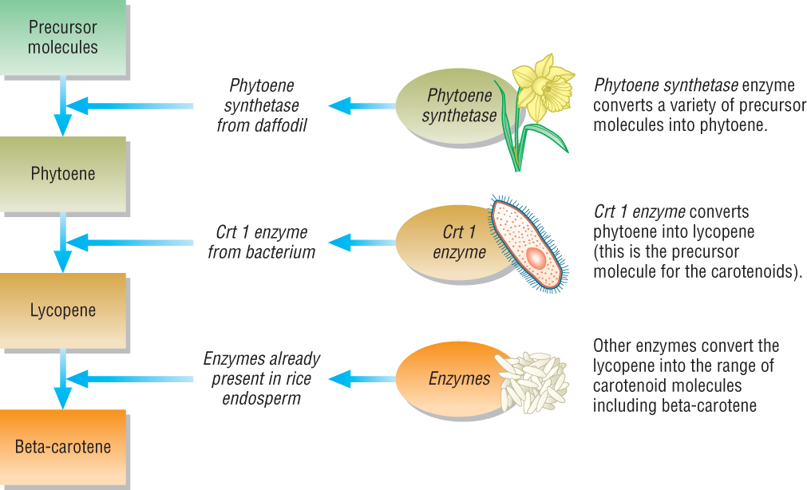

Slide 12
Further Developments
In the USA, golden rice has been cross bred producing hybrids which produce 3-4 times the amount of beta carotene than the original golden rice variety
In 2005, UK scientists developed golden rice 2 which has 20 times the amount
Full field trials will take place after 2011 when food safety investigations are complete
Golden rice given free by the GM company to allow people to grow it
Greenpeace says this is just a PR stunt to make GM crops acceptable and say:
Biodiversity will be reduced
Safety of GM rice is unknown
GM rice could breed with wild rice and contaminate wild rice populations
BUT no other solution has been offered!

Slide 13
4 marks
Discuss the potential benefits to mankind and the ethical concerns raised by rice modified to increase Vitamin A content (Golden rice)

Slide 14
4 marks
‘Golden RiceTM‘
B1 reduce vitamin (A) deficiency in named area eg Asia / developing world / area where rice is staple diet
B2 reduce, eye problems / blindness ;
C1 reduce rice genetic, diversity / variation ; ACCEPT contributes to genetic erosion
C2 clone may suffer from one, disease / environmental change ;
C3 hybridisation with wild rice / spread genes to wild populations ; C3 ACCEPT superweeds idea
C4 seeds expensive / need to be bought each year ; CREDIT idea of economic exploitation
C5 rice may not grow in all areas where needed ;
C6 idea of doubts whether vitamin A content sufficient
C12 antibiotic resistance gene transfer to pathogenic bacteria ;
C13 unknown effects / cause mutation ;

Slide 15
5 marks
Genetic engineering uses the following, name A-E
An enzyme that synthesis new DNA
An enzyme that cuts DNA at specific sequences
An enzyme that reseals cut ends of DNA
Small circular pieces of DNA found in bacteria; these pieces have antibiotic resistance genes
An enzyme found in some viruses with an RNA genome, this enzyme converts RNA into DNA

