Slide 1
Lesson 10
The Specific Immune Response
OCR AS Biology – F212 – Module 2
Food & Health

Slide 2
Starter Question January 2011
Linking the learning…
When an infection occurs, some lymphocytes produce cell signalling molecules called cytokines. These cytokines stimulate specific groups of B Lymphocytes to divide.
Describe how cytokine molecules can stimulate specific groups of B lymphocytes to divide
3 marks – 3 minutes
Individually

Slide 3
The cytokine receptor has a specific shape
Due to this the cytokine binds/attaches to this specific receptor
On the cell surface membrane of a B lymphocyte
Both the receptor and cytokine have complimentary shapes
This hen stimulates the B lymphocytes to divide by mitosis

Slide 4

Learning outcomes
LO: Describe the structure of T lymphocytes and B lymphocytes
Describe the mode of action of T lymphocytes and B lymphocytes
Describe the role of memory cells
Describe the significance of cell signalling.

Slide 5
Learning Objectives
Success Criteria
Understand the role of the specific immune system.
Understand the role of B and T Lymphocytes in fighting off pathogens.
State the role of antigen (E-D)
Describe how B & T lymphocytes detect antigens (D-C)
Describe the processes of clonal selection and expansion (C-B)
Explain how differentiated B & T lymphocytes fight off pathogens (B-A)

Slide 6
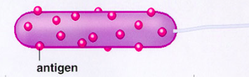
Detection of the Pathogen
Pathogens have antigens on their surface.
The antigens trigger the specific immune response.
Antigens have a specific shape.
They are usually a protein or glycoprotein.
Bacterial cell with antigens on its surface
Antigens on a pathogen are recognised as foreign.
The cells in the body responsible for detecting the antigens on the pathogens are:
&
B Lymphocytes
T Lymphocytes

Slide 7
B Lymphocytes & T Lymphocytes
B & T lymphocytes patrol the body for foreign antigens.
They have receptors in their membranes that are complementary to foreign antigens.
B
The B & T lymphocytes with the correct receptors must bind to the antigens for the immune response to start.
There are only a few of the correct B & T cells.
How can the B & T lymphocytes with correct receptors be helped in finding the antigens?
Communication: cell signalling!
receptors
T

Slide 8
Lymphocytes: specific immune response
B cells
T cells
Produced in bone marrow
Mature in bone marrow
Circulate in blood and lymph
Concentrate in lymph nodes and spleen
Respond to antigens
Secrete specific antibodies in response to antigens
Have receptors on surface: include versions of antibody molecule they produce.
Produced in bone marrow
Mature in thymus
Circulate in blood and lymph
Concentrate in lymph nodes and spleen
Respond to antigens
Have one specific type of antigen receptor on their surface: only binds to antigen with complimentary shape

Slide 9
Complete the worksheet
1-5

Slide 10
Presentation of the Antigens
There are 2 major ways in which the antigens can be presented to the B & T lymphocytes. What are they?
1. Infected cells display antigens on their surface
2. Macrophages also display antigens on their surface
Normal body cells infected with the pathogen will try to destroy it with lysosomes.
They then present the antigens on their surface as a distress signal.
When a macrophage phagocytoses a pathogen, it presents the antigens on its surface.
It acts as an ANTIGEN-PRESENTING CELL.
Infected body cell
Antigen being presented
Antigen being presented
Macrophage

Slide 11

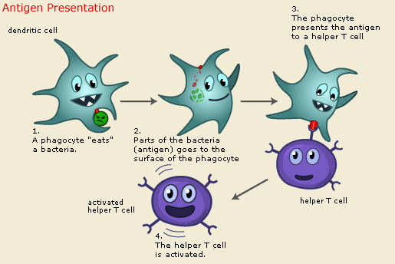
The selection of the correct B and T lymphocytes is known as clonal selection
Clonal Selection
Clonal Expansion
Followed
by...
To become effective at fighting the pathogen the lymphocytes must increase in number, this is clonal expansion

Slide 12
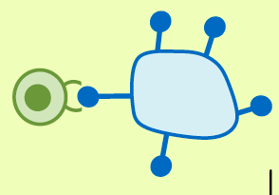
Clonal Selection & Expansion
Eventually, B & T lymphocytes with complementary receptors will detect the foreign antigen.
This is called CLONAL SELECTION.
Before the selected B and T lymphocytes can effectively fight the pathogen, they must increase in number.
They do this my mitosis, and this is called CLONAL EXPANSION.
Found you!
Pathogen
B or T Lymphocyte
Antigen

Slide 13
http://www.nobelprize.org/educational/medicine/immunity/immune-detail.html

Slide 14
Complete the worksheet
6-8

Slide 15

Differentiation of B & T Lymphocytes
Now, it is time for the B & T cells to differentiate (specialise).
The cells above play many roles in fighting off the pathogen.
The next couple of slides explain what their roles are.
T Lymphocytes
B Lymphocytes
T-helper
cells
T-killer cells
T-memory
cells
Plasma Cells
B-memory Cells

Slide 16
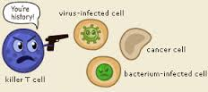
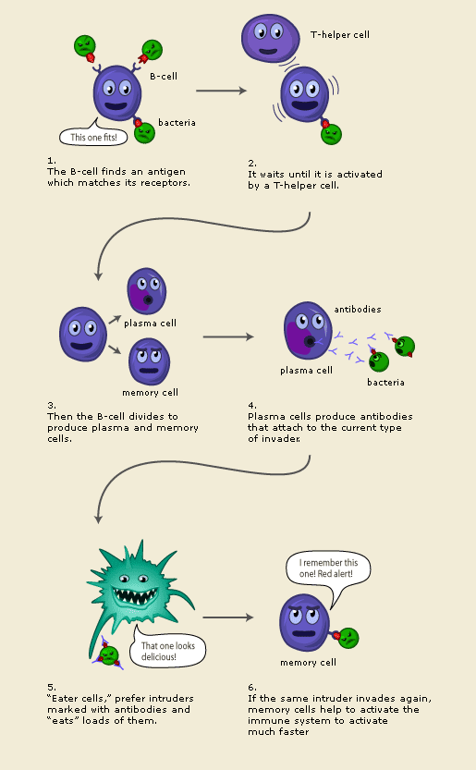
What do T Lymphocytes differentiate into?
T-killer Cells
Their job is quite simple:
Find and kill cells infected with
the pathogen.
T-memory Cells
These cells remain in the blood for a very long time.
They carry receptors for the pathogen and speed up
The immune response if the body is infected by the
same pathogen again.
Later that year...
T-helper Cells
These cells are messengers, and they
stimulate B cells to develop
More detail...

Slide 17
T-helper cells release chemicals called cytokines (chemical message) which stimulate the differentiation of B lymphocytes...
= Cytokine
Plasma Cells
T-helper release cytokines
A clonally selected B-lymphocyte
B-memory Cells

Slide 18
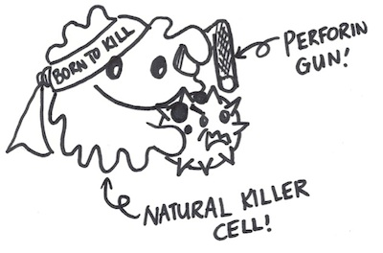
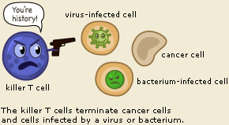
The T killer cells:
Destroy ANY cells with non self antigens on cell surface membrane!
Body cells with pathogens: viruses/bacteria
Transplant tissue!
Cancer cells!
HOW?
T killer cell releases chemicals causes pores to form in cell = lysis
Cell is destroyed and pathogen released which can be marked by antibodies
The debris from cell lysis by T killer cells is cleared away by macrophages.

Slide 19
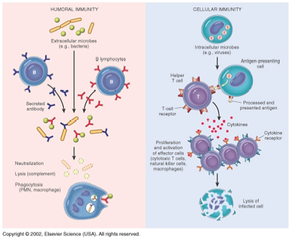
Complete the worksheet
9-10
The T cell response is known as the cellular (cell mediated) response
The B cell response is known as the humoral response

Slide 20
What do B Lymphocytes differentiate into?
Plasma Cells
These cells flow around the blood and manufacture and release antibodies.
Antibodies are proteins specific to the antigen of a pathogen.
B-memory Cells
These are similar to T-memory cells.
If the same pathogen invades the
body again, B-memory cells will
rapidly produce antibodies to
fight the infection.

Slide 22
Complete the worksheet
11-12
Quick review: look at the 2 diagrams page 171 and 173
Summarise in pairs what you now understand
Onto white boards identify the main stages

Slide 23
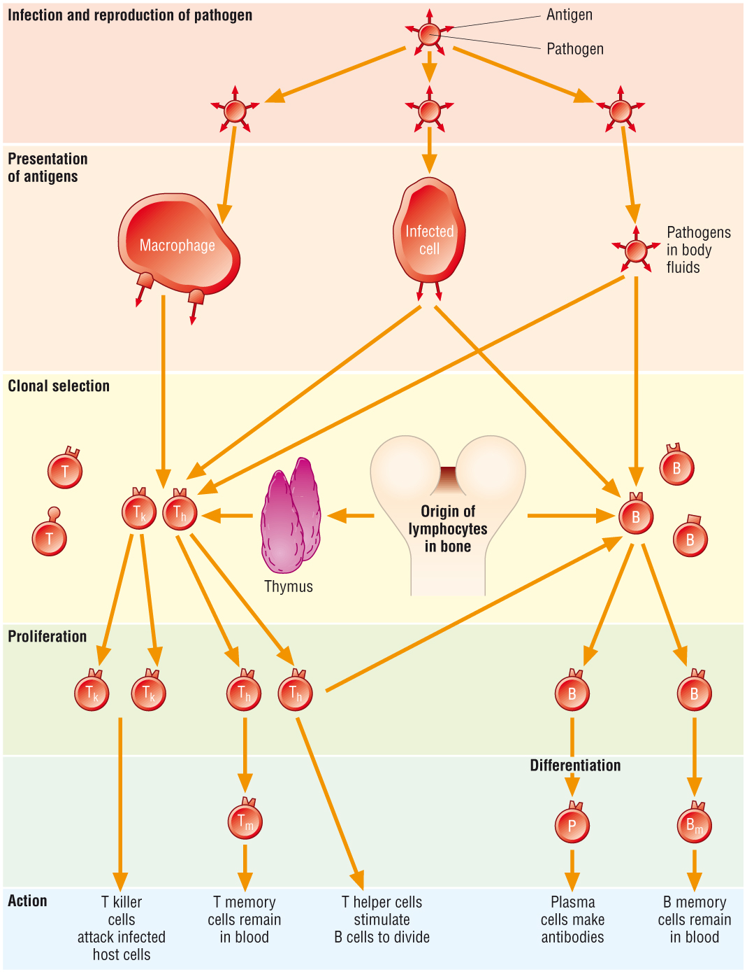
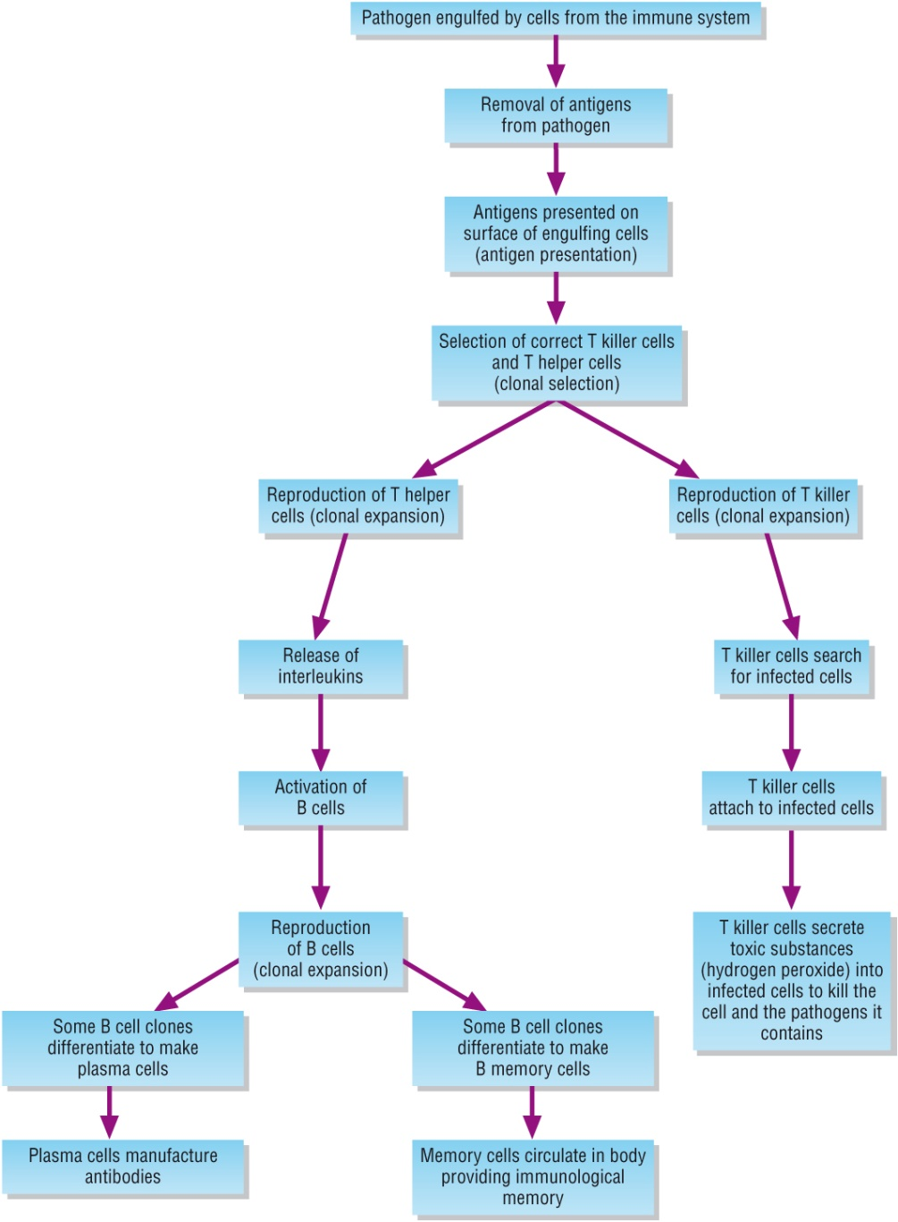

Slide 24
The stages in the immune response:
Infection by pathogen
Presentation of antigens: APCs: infected cells/macrophages or in body fluids
Clonal selection: selection by APCs of the specific cell
Clonal expansion: mitosis
Differentiation: B cells
Action

Slide 25
Task: in pairs
Using the text book pages 169-173
The diagrams given to you
PLAYDOH/ Diagrams summarise your understanding in the following stages
Presentation of antigens
Clonal selection of T cells
Clonal expansion of T cells
Clonal selection of B cells
Clonal expansion of B cells

Slide 26
Plenary
Complete the exam questions on your task sheet

Slide 27
How are viruses dealt with in the immune response? (2 marks)
Many cells can release interferon which can inhibit virus replication and stimulate the activity of T killer cells
Viruses invade body cells, these become APCs to enable detection and are destroyed by the T killer cells

Slide 28
2.Explain why the specific immune response is described as specific (4 marks)
Receptors on T cells and B cells have complementary shapes for a specific antigen.
Once activated, B cells produce antibodies which bind only with the specific complementary antigen.
T killer cells only lyse cells presenting the antigen complimentary to the T cell’s receptor.
Due to the recognition of antigens by complementary receptors on T and B cells, the specific immune response will result in destruction of only the specific antigen that activated the response.

Slide 29
Learning outcomes
LO: Describe the structure of T lymphocytes and B lymphocytes
Describe the mode of action of T lymphocytes and B lymphocytes
Describe the role of memory cells
Describe the significance of cell signalling.

Slide 30
This all takes time...

Slide 31
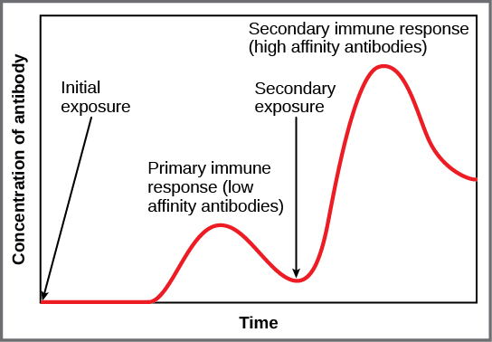
This all takes time...
Remember that the correct lymphocytes must be selected.
Then they must divide.
Then they much differentiate.
Then some cells must manufacture antibodies.
All of this means that it’s a few days before the number of antibodies in the blood starts to rise.
But, the immune response leaves memory cells in the blood.
If a second invasion occurs by the same pathogen, rapid production of plasma cells occurs, which releases antibodies quickly.

Slide 32
Task: Explain the role of the memory cells (2)
Memory cells remain in the body for years after an infection
They can produce a more rapid and vigorous secondary immune response when the body is invaded again by the same pathogen

Slide 33
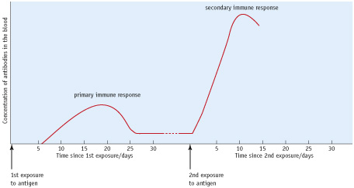
We have just learnt about the primary immune response...
What do we mean by the secondary immune response and how does it differ from the first?
Describe what the graph is telling you (4 marks)

Slide 34
If infected by same pathogen again the secondary immune response is much faster
Involves the memory cells and takes 2-7 days
B memory cells differentiate immediately and produce plasma cells and release antibodies
Greater production of antibodies: response last longer
Invading pathogen is destroyed so rapidly: unaware of symptoms.
Person is immune to the disease

Slide 35
Learning outcomes
LO: Describe the structure of T lymphocytes and B lymphocytes
Describe the mode of action of T lymphocytes and B lymphocytes
Describe the role of memory cells
Describe the significance of cell signalling.

