Slide 1
Learning outcomes:
All to collect hand out and use as I go through the lecture
Describe the mechanism of transport in the phloem involving active loading at the source and removal at the sink, and the evidence for and against this mechanism
Explain translocation as an energy-requiring process transporting assimilates (especially sucrose) between the sources and sinks.

Slide 2
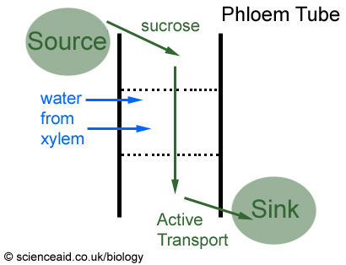
Translocation – the movement of sugars

Slide 3
Moving sugars around
The movement of “assimilates” (sugars and other chemicals needed by the plant) in the phloem is called translocation.
A source: releases sucrose into the phloem
A sink: removes sucrose from the phloem
The phloem is the main transporter of these materials and is responsible for moving sugars from the source (e.g. leaf/roots at some times of the year) to the part of the plant that requires it – Sink (e.g. roots or any new tissue growth e.g. new branches/buds to grow new leaves)

Slide 4
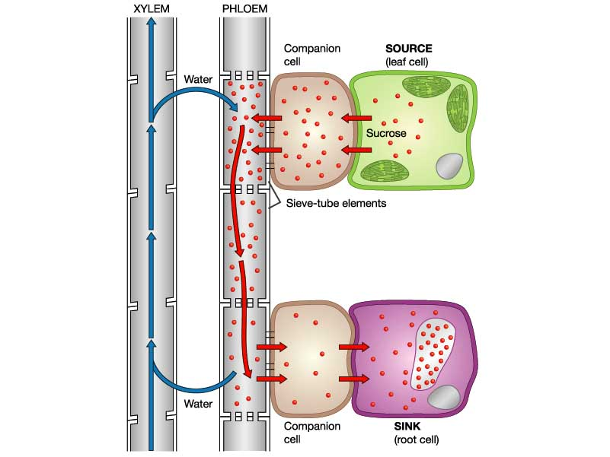
Part 1a starts here
Part 1b starts here

Slide 5
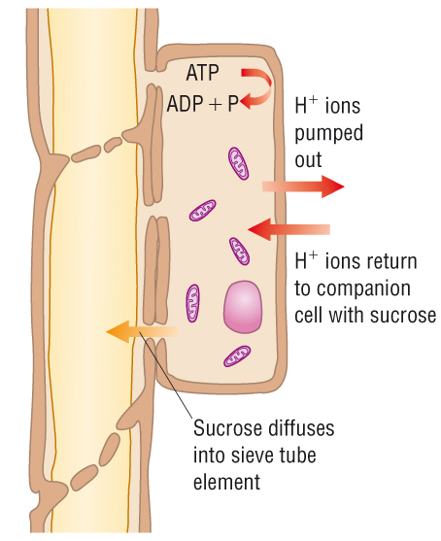
Part 1a – Getting the sucrose into the phloem tubes from the source
Special cells called companion cells actively (use of ATP) transport H⁺ ions (protons) out of their cytoplasm into surrounding tissue (e.g. leaf tissue where sucrose is being made)
H+ ions are now in higher concentration outside the companion cells and diffuse back

Slide 6
Part 1b
However on their return the H⁺ use a ‘co-transporter protein’ and are able to bring sucrose in with them (i.e. on their return they drag sucrose with them – this is a passive!) down a concentration gradient. Facilitated diffusion
The companion cells gain a higher and higher concentration of sucrose, which is then able to diffuse into the sieve tube elements via plasmodesmata (small pores in the cell membrane/cell wall between plant cells)

Slide 7
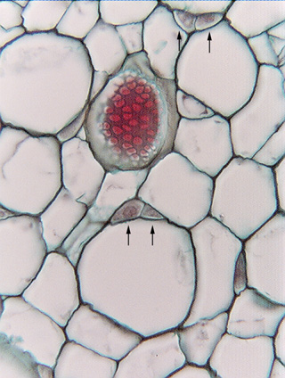
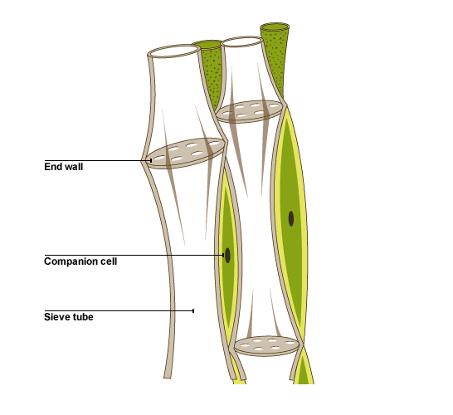
The black arrows are indicating companion cells (which work with the sieve tubes – the larger cells – shown with red arrows)
Together they are phloem
Notice that the companion cells have a nucleus and sieve tubes do not

Slide 8
Part 2 starts here

Slide 9
Part 2 – adding water (and creating a push)
So now the sieve tube element has a high conc. of sucrose (or low water potential)
This results in water moving into the sieve tube via osmosis
This therefore increases the hydrostatic pressure in the sieve tube forcing the solution downwards /upwards towards the sink
(Mass flow: either direction)

Slide 10
Part 3 occurs here at the sink

Slide 11
Part 3 – reaching ‘the sink’
As the sucrose solution flows (referred to as mass flow – n.b. this can happen up as well as down from the source) cells surrounding the phloem can take sucrose (either via diffusion or active transport)
This causes a drop in solute concentration (or increase in water potential) – this causes water to move into surrounding cells via osmosis (therefore at the sink the hydrostatic pressure reduces)

Slide 13
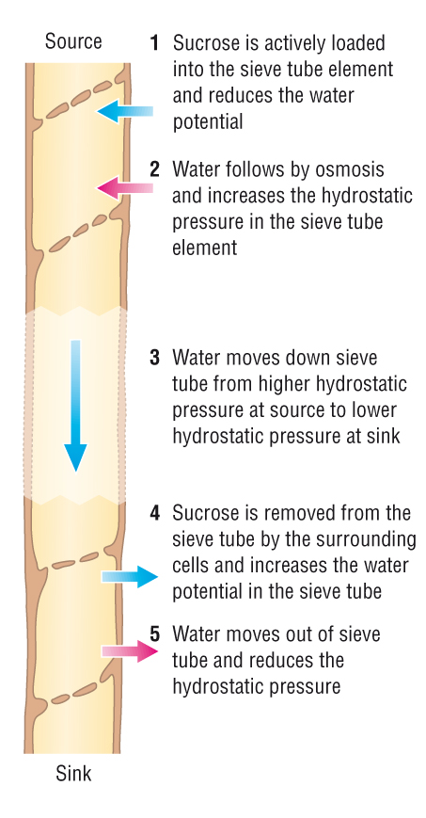

Slide 14
What are the key words you would have to include to describe how assimilates are loaded into the phloem
Companion
Gradient
Facilitated
Plasmodesmata
Sieve tube element
Diffuse/diffusion
Concentration
Cotransport
Sucrose
Hydrogen ions/protons

Slide 15
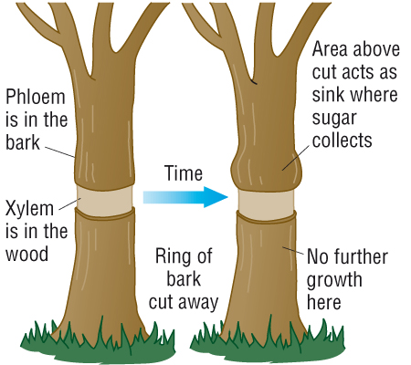
Evidence for and against this mechanism of translocation!
How we know phloem is used:
If a plant is supplied with radioactively labelled carbon dioxide (used in photosynthesis), the labelled carbon appears in the phloem
Ringing a tree to remove the phloem results in sugars collecting above the ring

Slide 16
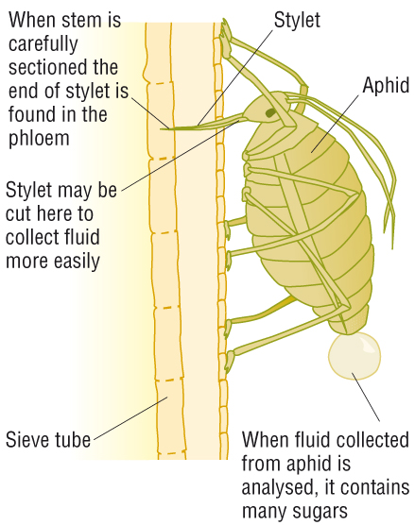
An aphid feeding on a plant stem can be used to show that food is being taken

Slide 17
How we know it needs metabolic energy: ATP
Companion cells have many mitochondria
Translocation can be stopped by using a metabolic poison that inhibits the formation of ATP
The rate of the flow of sugars in the phloem is so high that energy must be needed to drive the flow. It is calculated that sugars move up to 10 000 times more quickly by mass flow than they could by diffusion alone

Slide 18
How we know it uses this mechanism
The pH of companion cells is higher than that of the surrounding cells (protons pumped out)
The concentration of sucrose is higher in the source than the sink

Slide 19
Evidence against?
Not all solutes in phloem sap move at the same rate
Sucrose is moved to all parts of the plant at the same rate, rather than going to areas with a low concentration more quickly
The role of sieve plates is unclear.

Slide 20
Test
Exam questions!!

Slide 21
Learning outcomes:
All to collect hand out and use as I go through the lecture
Describe the mechanism of transport in the phloem involving active loading at the source and removal at the sink, and the evidence for and against this mechanism
Explain translocation as an energy-requiring process transporting assimilates (especially sucrose) between the sources and sinks.

